Slide 1
Multithreading
By
ALBIN JEGUS

Slide 2
Multithreading
A thread is the smallest unit of a program or process executed independently or scheduled by the Operating System.
In the computer system, an Operating System achieves multitasking by dividing the process into threads.
A thread is a lightweight process that ensures the execution of the process separately on the system.
In Python 3, when multiple processors are running on a program, each processor runs simultaneously to execute its tasks separately.

Slide 3
Multithreading aims to perform multiple tasks simultaneously, which increases performance, speed and
Each thread contains its own register set and local variables (stored in stack).
All thread of a process share global variables (stored in heap) and the program code.

Slide 4
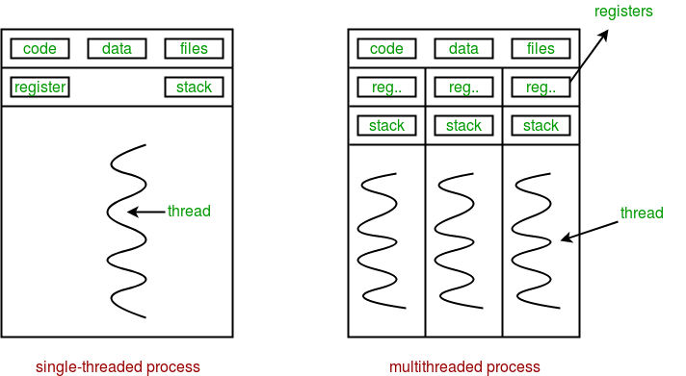
Multithreading

Slide 5
Advantages
It ensures effective utilization of computer system resources.
Multithreaded applications are more responsive.
It shares resources and its state with sub-threads (child) which makes it more economical.
It makes the multiprocessor architecture more effective due to similarity.
It saves time by executing multiple threads at the same time.
The system does not require too much memory to store multiple threads

Slide 6
When to use Multithreading in Python?
It is a very useful technique for time-saving and improving the performance of an application.
Multithreading allows the programmer to divide application tasks into sub-tasks and simultaneously run them in a program.
It allows threads to communicate and share resources such as files, data, and memory to the same processor. Furthermore, it increases the user's responsiveness to continue running a program even if a part of the application is the length or blocked.

Slide 7
Modules
There are two main modules of multithreading used to handle threads in Python.
The thread module
The threading module

Slide 8
Thread modules
It is started with Python 3, designated as obsolete, and can only be accessed with _thread that supports backward compatibility.
Syntax:
thread.start_new_thread ( function_name, args[, kwargs] )

Slide 9
import _thread
import time
def A(message):
count=0
while(count<5):
count+=1
time.sleep(3)
print("T-A")
def B(message):
count=0
while(count<5):
count+=1
time.sleep(4)
print("T-B")
_thread.start_new_thread(A,("Thread_A",))
_thread.start_new_thread(B,("Thread_B",))
while(1):
pass

Slide 10
import _thread
import time
def print_time(threadName, delay):
count = 0
while count < 5:
time.sleep(delay)
count += 1
print("%s: %s" %(threadName, time.ctime(time.time())))
try:
_thread.start_new_thread( print_time,("Thread-1", 2,))
_thread.start_new_thread( print_time,("Thread-2", 4,))
except:
print("Error: unable to start thread")
while 1:
pass

Slide 11
import threading
def print_hello(n):
Print("Hello, how old are you? ", n)
T1 = threading.Thread( target = print_hello, args = (20,))
T1.start()
T1.join()
print("Thank you")

Slide 12
import threading
Import time
def print_hello():
print("Hai”)
T1 = threading.Thread( target = print_hello)
Time.sleep(3)
T1.start()
T1.join()
print("Thank you")

Slide 13
import threading
Import time
def display():
for I in range(5)
time.sleep(2)
print(“tread started”)
T1 = threading.Thread( target = display)
T1.start()
import threading
Import time
def display(x,t):
for I in range(x)
time.sleep(t)
print(“tread started”)
T1 = threading.Thread( target = display,args=(10,2))
T1.start()

Slide 14
import time
import threading
from threading import *
def cal_sqre(num):
print(" Calculate the square root of the given number")
for n in num:
time.sleep(0.3)
print(' Square is : ', n * n)
def cal_cube(num):
print(" Calculate the cube of the given number")
for n in num:
time.sleep(0.3)
print(" Cube is : ", n * n *n)
ar = [4, 5, 6, 7, 2]
t = time.time()
th1 = threading.Thread(target=cal_sqre, args=(ar, ))
th2 = threading.Thread(target=cal_cube, args=(ar, ))
th1.start()
th2.start()
th1.join()
th2.join()
print(" Total time taking by threads is :", time.time() - t) # print the total time
print(" Again executing the main thread")
print(" Thread 1 and Thread 2 have finished their execution.")

Slide 15
Synchronization in thread
T1 = threading.Thread( target = runthread,args=("thread1",))
T2 = threading.Thread( target = runthread,args=("thread2",))
T3 = threading.Thread( target = runthread,args=("thread3",))
T1.start()
T2.start()
T3.start()
T1.join()
T2.join()
T3.join()
import threading
import time
lock=threading.Lock()
def runthread(name):
time.sleep(3)
lock.acquire()
display(name)
lock.release()
def display(name):
for i in range(5):
time.sleep(2)
print(name,"output",i)

Slide 16
import threading
import time
def runthread(name):
time.sleep(3)
display(name)
def display(name):
for i in range(5):
time.sleep(2)
print(name,"output",i)
T1 = threading.Thread( target = runthread,args=("thread1",))
T2 = threading.Thread( target = runthread,args=("thread2",))
T3 = threading.Thread( target = runthread,args=("thread3",))
T1.start()
T2.start()
T3.start()
T1.join()
T2.join()
T3.join()

Slide 17
import time
def cal_sqre(num):
print(" Calculate the square root of the given number")
for n in num:
time.sleep(0.9)
print(' Square is : ', n * n)
def cal_cube(num):
print(" Calculate the cube of the given number")
for n in num:
time.sleep(0.3)
print(" Cube is : ", n * n *n)
arr = [4, 5, 6, 7, 2]
t1 = time.time()
cal_sqre(arr)
cal_cube(arr)
print(" Total time taken by threads is :", time.time() - t1)

